Slide 1
Recursion
What is Recursion?
Recursive functions: Factorials
Advantages and Disadvantages of Recursion
Recursive functions: Fibonacci Sequence
Recursion vs. Iteration

Slide 2
Recursive Functions in Python: Factorials
In Python, a function can call other functions. It is even possible for the function to call itself. These type of constructs are called recursive functions.
Following is an example of recursive function to find the factorial of an integer. Factorial of a number is the product of all the integers from 1 to that number. For example, the factorial of 6 (denoted 6!) is 1*2*3*4*5*6 = 720.
Note: 0! = 1
Notes:
Recursion is a way of programming or coding a problem, in which a function calls itself one or more times in its body. If a function definition fulfils the condition of recursion, we call this function a recursive function.
In order to get an idea about recursion, we would be now looking at an example of a recursive function that calculates factorials of a non-negative integer. Before that, we should know what factorials are. For those who don’t know what factorials are, factorial of a non-negative integer is nothing but the product of all the positive integers less than or equal to the number. So 6! Would be 1 * 2 * 3* 4 * 5 * 6 that is 720. Also note that the factorial of 0 is 1.

Slide 3
Coding Factorials
# An example of a recursive function to # find the factorial of a number def fact(x): """This is a recursive function to find the factorial of an integer""" if x <= 1: return 1 else: return (x * fact(x-1)) num = int(input("Enter a number: ")) if num >= 1: print("The factorial of", num, "is", fact(num))
Notes:
Here we have a recursive function - fact. It is recursive since it calls itself. When we call this function with a non-negative integer, it will recursively call itself by decreasing the number by 1. Therefore, each function call basically results in the multiplication of the number with the factorial of predecessor of the number until the number itself becomes 1.
Over here I would like you to notice when the recursion ends. It ends when the number becomes 1.

Slide 4
How is the result interpreted?
The output is: Enter a number: 4 The factorial of 4 is 24
As we’ve seen before, our recursion ends when the number reduces to 1. This is called the base condition. Every recursive function must have a base condition that stops the recursion or else the function calls itself infinitely. We must avoid infinite recursion.
Let's see how the function calls itself in the next slide.
The output is: Enter a number: 4 The factorial of 4 is 24
Notes:
The output from our function would be 24 if our input is 4. We would shortly see how each function call was made and how we reached to our final solution.
As we saw in the previous slide, the recursion ends when the number is reduced to "1". A recursive function terminates, if with every recursive call converges to a base case. In the case where a base case is not handled or where the recursion doesn’t converge to the base case, we might have infinite recursion.

Slide 5
Factorials Step to Step
fact(4) # 1st call with 4 4 * fact(3) # 2nd call with 3 4 * 3 * fact(2) # 3rd call with 2 4 * 3 * 2 * fact(1) # 4th call with 1 4 * 3 * 2 * 1 # return from 4th call as x = 1 4 * 3 * 2 # return from 3rd call 4 * 6 # return from 2nd call 24 # return from 1st call
Notes:
Now to understand function evaluation in general, and recursive processes in particular we would take the help of a tool called The substitution model of evaluation.
Our first call of fact has an integer argument of 4. Over here we would need to multiply 4 by the factorial of the predecessor of 4 i.e. 3. This would further result in another recursive call where the argument is 3 and that would result in another recursive call where the argument is 2. Our recursive calls would end when the argument is equal to 1 where the value of 1 would be returned. After 1 has been returned by our final recursive call we will go back to the point from where the recursive call was made and that would be the point where our argument was 2. The product of 2 and 1 is calculated and then value is returned. This process will continue till we reach our original functional call.

Slide 6
Advantages of recursion
Recursive functions make the code look clean and elegant.
A complex task can be broken down into simpler sub-problems using recursion (divide-and conquer paradigm).
Sequence generation is easier with recursion than using some nested iteration. We will return to this subject later.
Notes:
Recursion has some advantages like it makes our code look cleaner and that it is extremely helpful if we are solving a problem using the divide and conquer paradigm where we break a complex problem into much simpler sub problems and then solve them individually.
Furthermore sequence generation is easier using recursion that using a nested loop. Nested Loop is a loop within a loop, like an inner loop within the body of an outer one. How this works is that the first pass of the outer loop triggers the inner loop, which executes to completion. Then the second pass of the outer loop triggers the inner loop again. This repeats until the outer loop finishes. Of course, a break within either the inner or outer loop would interrupt this process. This break is what we have called in the previous slide base condition. We will talk more about this later.

Slide 7
Disadvantages of recursion
Logic behind recursion is hard to follow
Expensive (inefficient) - take up a lot of memory and time.
Hard to debug.
Notes:
The logic behind recursion sometimes can be hard to follow and therefore problems may arise during debugging of the code. Recursive calls are also inefficient, as we will further see, since they take up a lot of memory and time even at the speed of a computer.

Slide 8
Getting started with Recursion : The Fibonacci Sequence
F₀ = 0
F₁ = 1
F₂ = 0 + 1 = 1
F₃ = 1 + 1 = 2
F₄ = 2 + 1 = 3
0, 1, 1, 2, 3, 5, 8, 13, 21, 34, ...
Notes:
One of the things that quickly relate to the word "recursion" is called the Fibonacci Sequence.
* 0, 1, 1, 2, 3, 5, 8, 13, 21, 34, ... each number in the sequence is the result of adding the two previous numbers. An easy rule that only marks the beginning and the calculation method, but not the end. The Fibonacci sequence is named after the mathematician Leonardo of Pisa, who is better known as Fibonacci. In his book "Liber Abaci" (published in 1202) he introduced the sequence as an exercise dealing with bunnies. His sequence of the Fibonacci numbers begins with F1 = 1, while in modern mathematics the sequence starts with F0 = 0. But this has no effect on the other members of the sequence. * The Fibonacci numbers are the result of an artificial rabbit population, satisfying the following conditions: - a newly born pair of rabbits, one male, one female, build the initial population - these rabbits are able to mate at the age of one month so that at the end of its second month a female can bring forth another pair of rabbits - these rabbits are immortal - a mating pair always produces one new pair (one male, one female) every month from the second month onwards The Fibonacci numbers are the numbers of rabbit pairs after n months, i.e. after 10 months we will have F10 rabbits.

Slide 9
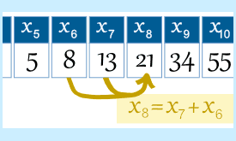
Deceptively Simple - 1
We can define the Fibonacci’s sequence F(n) as a recurrence relation:
F(n) = F(n-1) + F(n-2)
With initial values: F(0) = 0, F(1) = 1 and n > 1
Notes:
We can represent the fibonacci sequence, like other sequences, in the form of a recurrence relation.
In recurrence relations each further term of the sequence is defined as a function of the preceding terms.As we can see, in the recurrence relation of the fibonacci sequence, the nth element of the sequence, where n is greater than 1, is the sum of the two previous elements of the sequence. In the relation we have also defined the initial values of the zeroth and the first element of the sequence to be 0 and 1 respectively.
As mentioned, it is only necessary to add the last two terms of the sequence to calculate the next. How could we see this idea in Python?

Slide 10
Defectively simple - 2
An easy recursive implementation of how to calculate a Fibonacci number in Python, specifically the nth number in the sequence:
def fib(n): if n == 0: return 0 elif n == 1: return 1 else: return fib(n-1) + fib(n-2)
Notes:
Here is a function fib, that calculates the nth element of the fibonacci sequence. It's more or less a one to one mapping of the recursive relation we saw in the previous slide. The base cases here are when the argument n in the function call is either 0 or 1. If we have a number n greater than 1 then we make two other recursive calls, which may lead to more recursive calls themselves, to get the previous two terms in the sequence so that we can add them to get the nth element.

Slide 11
Defectively simple - 3
An iterative solution for the same problem is also easy to write.
def fib(n): a, b = 0, 1 for i in range(n): a, b = b, a + b return a
Notes:
An iterative solution for the problem is also easy to write, though the recursive solution looks more like the mathematical definition.

Slide 12
Defectively simple - 4
We can make a performance comparison between the recursive and the iterative methods.
from timeit import Timer from fibo import fib
t1 = Timer("fib(10)","from fibo import fib")
for i in range(1,41): s = "fib(" + str(i) + ")" t1 = Timer(s,"from fibo import fib") time1 = t1.timeit(3) s = "fibi(" + str(i) + ")" t2 = Timer(s,"from fibo import fibi") time2 = t2.timeit(3) print("n=%2d, fib: %8.6f, fibi: %7.6f, percent: %10.2f" % (i, time1, time2, time1/time2))
Notes:
If we check the functions fib() and fibi(), we will find out that the iterative version fibi() is a LOT FASTER than the recursive version fib(). To get an idea of how much this "a lot faster" can be, we use the timeit module to measure the calls, as a benchmark to compare different solutions.
time1 is the time in seconds it takes for 3 calls to fib(n) and time2 respectively the time for fibi(). If we look at the results, we can see that calling fib(20) three times needs about 14 milliseconds. fibi(20) needs just 0.011 milliseconds for 3 calls. So fibi(20) is about 1300 times faster then fib(20).
fib(40) needs already 215 seconds for three calls, while fibi(40) can do it in 0.016 milliseconds. fibi(40) is more than 13 millions times faster than fib(40). Why is it so? Let’s see.

Slide 13
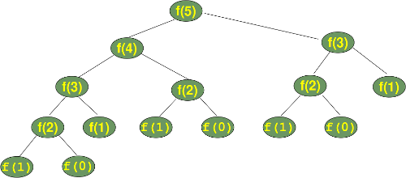
What's wrong with The recursive implementation?
Let's have a look at the calculation tree, i.e. the order in which the functions are called. fib() is substituted by f().
Notes:
Let's have a look at the calculation tree, i.e. the order in which the functions are called. fib() is substituted by f() over here
We can see that the subtree f(2) appears 3 times and the subtree for the calculation of f(3) two times. If you imagine extending this tree for f(6), you will understand that f(4) will be called two times, f(3) three times and so on. This means, our recursion doesn't remember previously calculated values. Every recursive call needs to reach the base case even if some other recursive called has reached the base case before. These extra calls are adding to the time taken by the function to calculate the nth element of the sequence and hence making the recursive method inefficient.

Slide 14
What if we add "memory" to the recursion?
We can implement a memory for our recursive version by using a dictionary to save the previously calculated values.
memo = {0:0, 1:1} def fibm(n): if not n in memo: memo[n] = fibm(n-1) + fibm(n-2) return memo[n]
n= 1, fib: 0.000011, fibi: 0.000015, percent: 0.73 n= 2, fib: 0.000011, fibi: 0.000013, percent: 0.85 n= 3, fib: 0.000012, fibi: 0.000014, percent: 0.86 n= 4, fib: 0.000012, fibi: 0.000015, percent: 0.79 n= 5, fib: 0.000012, fibi: 0.000016, percent: 0.75
Notes:
We can see that it is even faster than the iterative version. Of course, the larger the arguments the greater the benefit of our memoization.

Slide 15
Recursion versus Iteration
A recursive function is one that “calls” itself.
Iteration keeps repeating until a task is “done”.
Both recursion and iteration perform the same kind of tasks, but…
Recursion solve a large problem by breaking it up into smaller and smaller pieces until you can solve it; combine the results.
Which is “better”?
Notes:
-No clear answer, but there are known trade-offs
-“Mathematicians” often prefer recursive approach. Solutions often shorter, closer in spirit to abstract
mathematical entity, but good recursive solutions may be more difficult to design and test.
-“Programmers”, esp. w/o college CS training, often prefer iterative solutions. !
- Somehow, it seems more appealing to many. Control stays local to loop, less “magical”.

Slide 16
Recursion to solve problems: The Towers of Hanoi.
Notes:
There is an old legend about a temple or monastery, which contains three poles. One of them filled with 64 gold disks. The disks are of different sizes, and they are put on top of each other, according to their size, i.e. each disk on the pole a little smaller than the one beneath it. The priests, if the legend is about a temple, or the monks, if it is about a monastery, have to move this stack from one of the three poles to another one. But one rule has to be applied: a large disk can never be placed on top of a smaller one. When they would have finished their work, the legend tells, the temple would crumble into dust, and the world would end.

Slide 17
Recursion to solve problems: The Towers of Hanoi.
2⁶⁴ - 1 = 18,446,744,073,709,551,615
Notes:
But don't be afraid, it's not very likely that they will finish their work soon, because 2⁶⁴ - 1 moves are necessary, i.e. 18,446,744,073,709,551,615 to move the tower according to the rules.
But there is - most probably - no ancient legend. The legend and the game "towers of Hanoi" had been conceived by the French mathematician Edouard Lucas in 1883.

Slide 18
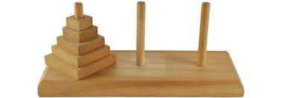
The Towers of Hanoi
Uses three rods
Disks stacked in decreasing order from the bottom to the top of one rod building a conical tower
Notes:
The game "Towers of Hanoi" uses three rods. A number of disks are stacked in decreasing order based on their sizes, from the bottom to the top of one rod, i.e. the largest disk is at the bottom of the rod and the smallest one is on the top. As we can see in the image. The disks build a conical tower.
The aim of the game is to move the all the disks from one rod to another rod.

Slide 19
rules of the game
AIM: To move the tower of disks from one rod to another rod.
One disk may be moved at a time.
Uppermost disk from one of the rods can be moved in a move
Disk can be placed only if the rod is empty or if the uppermost disk of the rod is larger than the one being moved.
Notes:
However one cannot just simply pick up the stack of disks and place on another rod. There are a few rules that have to be obeyed:
Firstly, Only one disk may be moved at a time. And that disk has to be the uppermost disk from one of the rods. Also, we have to keep in mind that the disk being moved has to be smaller than the uppermost disk of the rod, the disk is being moved to. So basically no disk can be placed on top of a smaller disk at any point of time.
The rules of the game are very simple, but the solution is not so obvious.

Slide 20
“Towers of Hanoi” problem
Number of moves necessary : 2^{n} - 1, n = number of disks
7 moves to move a tower of size 3
Target
AUX
Source
Notes:
The number of moves necessary to move a tower with n disks can be calculated as: 2^{n} - 1
From the formula above, we know that we need 7 moves to move a tower of 3 disks from the leftmost rod let's call it SOURCE. To the rod in the middle which we will call the TARGET.
The pole in the right (we will call it AUX) is needed as an auxiliary stack to deposit disks temporarily.
Before we examine the case with 3 disks, as it is depicted in the image on the right side, we will have a look at towers of size 1 (i.e. just one disk) and size 2.

Slide 21
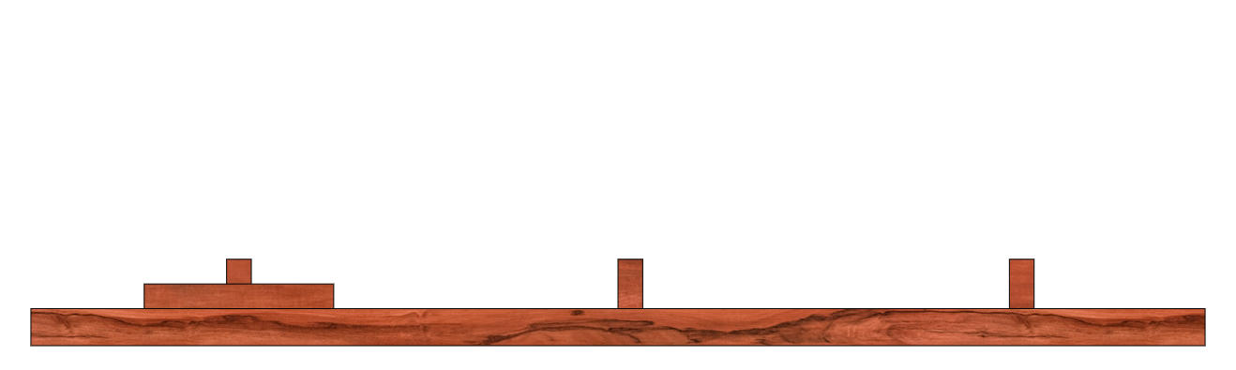
“Towers of Hanoi” problem: 1 disk
Notes:
The solution for a tower with just one disk is straightforward: We will move the one disk on the SOURCE tower to the TARGET tower and we are finished. Not there is no use of the auxiliary peg in this case.

Slide 22
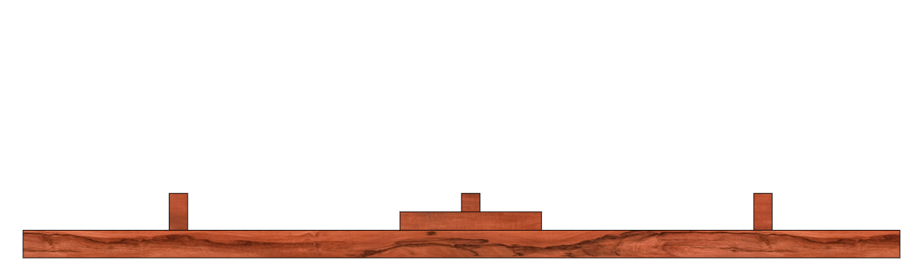
“Towers of Hanoi” problem: 1 disk

Slide 23
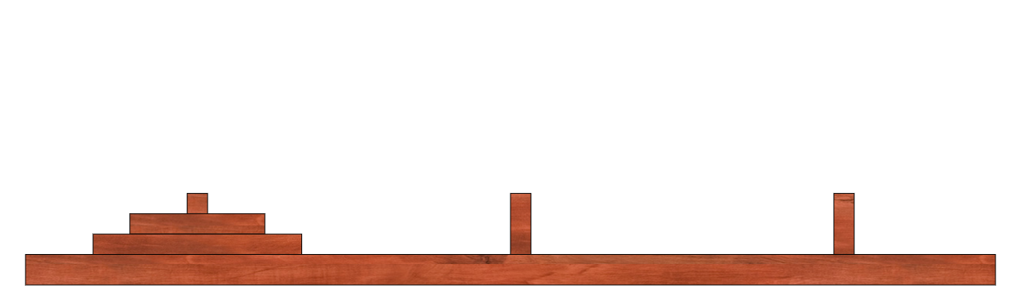
“Towers of Hanoi” problem: 2 disks
Notes:
Let's look now at a tower with size 2, i.e. two disks. There are two possibilities to move the first disk, the disk on top of the stack of SOURCE: We can move this disk either to TARGET or to AUX.
So let's start by moving the smallest disk from SOURCE to TARGET.

Slide 24
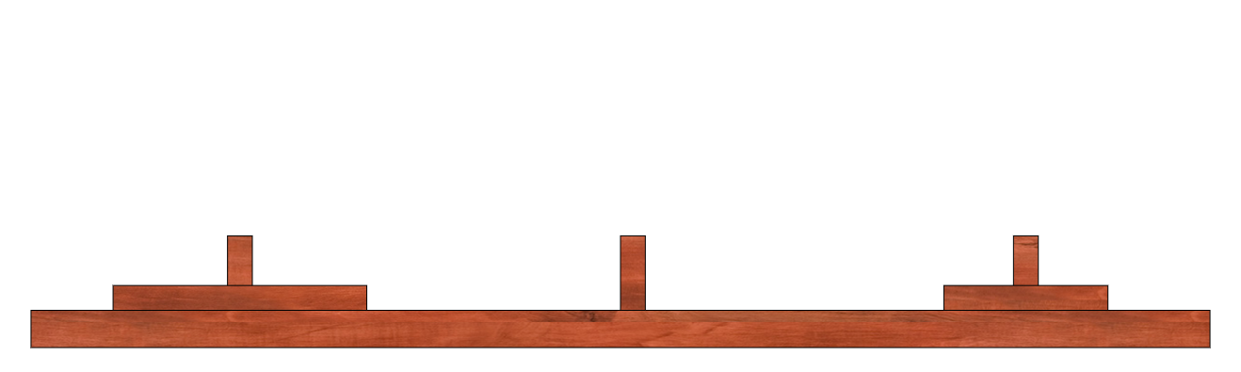
“Towers of Hanoi” problem: 2 disks
Notes:
Now there are two choices: We can move this disk again, either back to the SOURCE peg, which obviously doesn't make sense, or we could move it to AUX, which doesn't make sense either, because we could have moved it there as our first step.
So the only move which makes sense is moving the other disk, i.e. the largest disk, to AUX. Now, we have to move the smallest disk again, because we don't want to move the largest disk back to SOURCE again. We can move the smallest disk to AUX. Moving the smallest disk from peg SOURCE to TARGET as our first step has not shown to be successful. So, we will move this disk to peg AUX in our first step. After this we move the second disk to TARGET. After this we move the smallest disk from AUX to TARGET and we have finished our task!

Slide 25
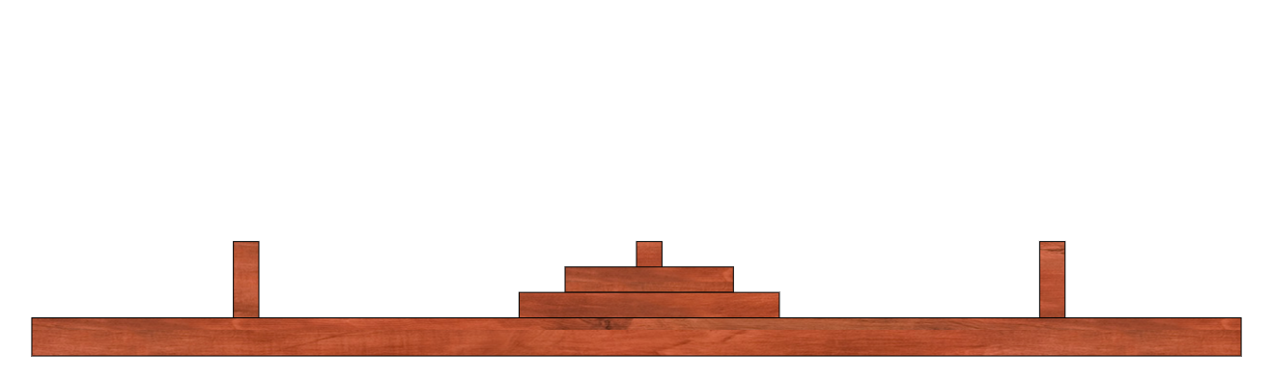
“Towers of Hanoi” problem: 2 disks
Notes:
Now we can see that we have moved the tower of size 2 to the peg AUX, but the target had been peg TARGET. We have already used the maximal number of moves, i.e. 22 - 1 = 3

Slide 26
“Towers of Hanoi” problem: 2 disks
Notes:
Moving the smallest disk from peg SOURCE to TARGET as our first step has not shown to be successful.

Slide 27
“Towers of Hanoi” problem: 2 disks
Notes:
So, we will move this disk to peg AUX in our first step.

Slide 28
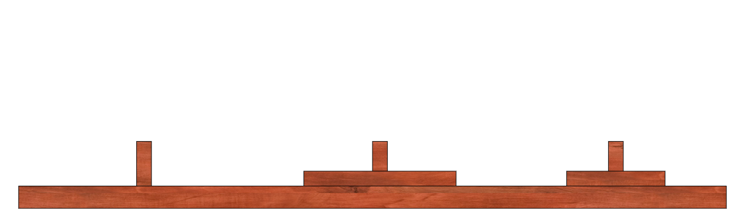
“Towers of Hanoi” problem: 2 disks
Notes:
After this we move the second disk to TARGET.

Slide 29
“Towers of Hanoi” problem: 2 disks
Notes:
And finally we move the smallest disk from AUX to TARGET and we have finished our task!

Slide 30
Recursive solution to the “Towers of Hanoi” problem
Move n-1 disks from source to auxiliary using target peg as a spare
Move nth disk from source to target
Move n-1 disks from the auxiliary peg to the target peg
Notes:
We have seen how we solve the problem when we have 1 disk and 2 disks. Now let’s see how we solve the problem when we have 3 disks. For this we’ll use the recursive approach which involves 3 steps.
Move n-1 disks from source to aux using target peg as a place to temporarily store disks. In this case we will move 2 disks first
Then we have to move the nth disk from the source to the target. In this case it would be the third disk
And finally we move the n-1 disks from the aux peg to the target peg
To implement this, we will write a recursive function that takes 4 parameter - Disks that need to be moved, Source Peg from where the disks need to be moved, Auxiliary Peg which will be aux peg to temporarily store the disks and the target Peg to which the disk should be moved. Note that in each recursive call the target and helper pegs might change and would not be the same as our original target and helper peg as we will shortly. However after completion our disks would be present at the intended target peg

Slide 31
Recursive solution to the “Towers of Hanoi” problem
def hanoi(n, source, target, aux): if n > 0: # move tower of size n - 1 to aux: hanoi(n - 1, source, aux, target) # move disk from source peg to target peg if source: target.append(source.pop()) # move tower of size n-1 from aux to target hanoi(n - 1, aux, target, source) source = [3,2,1] target = [] aux = [] hanoi(len(source),source,target,aux) print source, target, aux
Notes:
Disks that need to be moved, Source Peg from where the disks need to be moved, Auxiliary Peg which will be aux peg to temporarily store the disks and the Destination Peg to which the disk should be moved.
Over here our base case is when we have only 1 peg remaining since we can then move the peg directly from the source to the target peg.

Slide 32
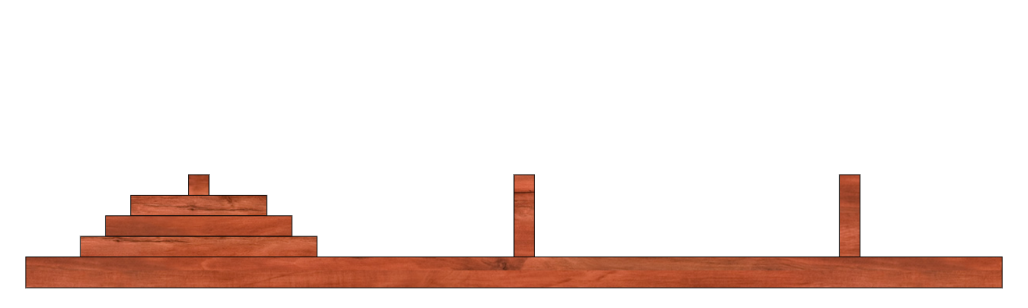
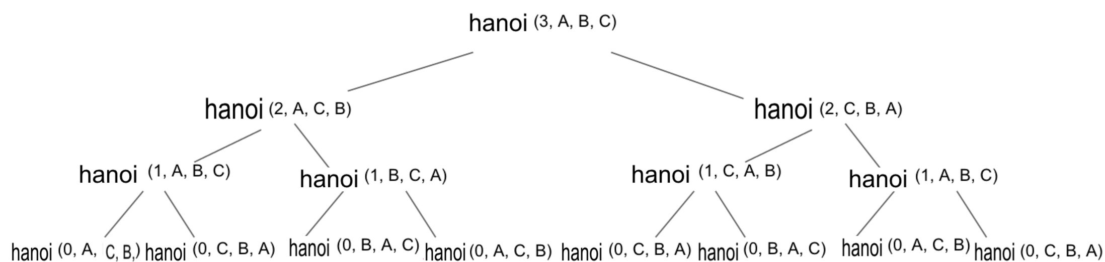
Recursive solution to the “Towers of Hanoi” problem
def hanoi(n, source, target, aux): if n > 0: # move tower of size n - 1 to aux: hanoi(n - 1, source, aux, target) # move disk from source peg to target peg if source: target.append(source.pop()) # move tower of size n-1 from aux to target hanoi(n - 1, aux, target, source) source = [3,2,1] target = [] aux = [] hanoi(len(source),source,target,aux) print source, target, aux
A B C
N = 3 Source Target Aux
Notes:
Now let’s see how it works. From now on i’ll refer to the leftmost peg as A, the centre peg as b and the rightmost peg as c.
Our initial call would have arguments 3, A, B and C respectively. That means we have to move 3 disks from source A to target B using C as a spare. The first step, According to our algorithm, is to move the top 2 disks from A to C using B as a spare and to this our function would have a recursive call with arguments 2, A, C and B respectively. Now for the 2 disks, again the first step is to move 1 disk from the source that is A to the auxiliary ,that would be B in this case, using C as a spare. This would result in another recursive call with the arguments 1 , A, B and C respectively

Slide 33
Recursive solution to the “Towers of Hanoi” problem
def hanoi(n, source, target, aux): if n > 0: # move tower of size n - 1 to aux: hanoi(n - 1, source, aux, target) # move disk from source peg to target peg if source: target.append(source.pop()) # move tower of size n-1 from aux to target hanoi(n - 1, aux, target, source) source = [3,2,1] target = [] aux = [] hanoi(len(source),source,target,aux) print source, target, aux
A B C
N = 2 Source Aux Target
Notes:
Now let’s see how it works. From now on i’ll refer to the leftmost peg as A, the centre peg as b and the rightmost peg as c.
Our initial call would have arguments 3, A, B and C respectively. That means we have to move 3 disks from source A to target B using C as a spare. The first step, According to our algorithm, is to move the top 2 disks from A to C using B as a spare and to this our function would have a recursive call with arguments 2, A, C and B respectively. Now for the 2 disks, again the first step is to move 1 disk from the source that is A to the auxiliary ,that would be B in this case, using C as a spare. This would result in another recursive call with the arguments 1 , A, B and C respectively

Slide 34
Recursive solution to the “Towers of Hanoi” problem
def hanoi(n, source, target, aux): if n > 0: # move tower of size n - 1 to aux: hanoi(n - 1, source, aux, target) # move disk from source peg to target peg if source: target.append(source.pop()) # move tower of size n-1 from aux to target hanoi(n - 1, aux, target, source) source = [3,2,1] target = [] aux = [] hanoi(len(source),source,target,aux) print source, target, aux
A B C
N = 1 Source Target Aux
Notes:
Now let’s see how it works. From now on i’ll refer to the leftmost peg as A, the centre peg as b and the rightmost peg as c.
Our initial call would have arguments 3, A, B and C respectively. That means we have to move 3 disks from source A to target B using C as a spare. The first step, According to our algorithm, is to move the top 2 disks from A to C using B as a spare and to this our function would have a recursive call with arguments 2, A, C and B respectively. Now for the 2 disks, again the first step is to move 1 disk from the source that is A to the auxiliary ,that would be B in this case, using C as a spare. This would result in another recursive call with the arguments 1 , A, B and C respectively

Slide 35
Recursive solution to the “Towers of Hanoi” problem
def hanoi(n, source, target, aux): if n > 0: # move tower of size n - 1 to aux: hanoi(n - 1, source, aux, target) # move disk from source peg to target peg if source: target.append(source.pop()) # move tower of size n-1 from aux to target hanoi(n - 1, aux, target, source) source = [3,2,1] target = [] aux = [] hanoi(len(source),source,target,aux) print source, target, aux
A B C
N = 0 Source Aux Target
Notes:
Now let’s see how it works. From now on i’ll refer to the leftmost peg as A, the centre peg as b and the rightmost peg as c.
Our initial call would have arguments 3, A, B and C respectively. That means we have to move 3 disks from source A to target B using C as a spare. The first step, According to our algorithm, is to move the top 2 disks from A to C using B as a spare and to this our function would have a recursive call with arguments 2, A, C and B respectively. Now for the 2 disks, again the first step is to move 1 disk from the source that is A to the auxiliary ,that would be B in this case, using C as a spare. This would result in another recursive call with the arguments 1 , A, B and C respectively. At this point of time, another recursive call would be made where the number of disks to be transferred would be 0. However, nothing will happen here since there is nothing to be moved. So we will go back to the point where this recursive call was made from.

Slide 36
Recursive solution to the “Towers of Hanoi” problem
def hanoi(n, source, target, aux): if n > 0: # move tower of size n - 1 to aux: hanoi(n - 1, source, aux, target) # move disk from source peg to target peg if source: target.append(source.pop()) # move tower of size n-1 from aux to target hanoi(n - 1, aux, target, source) source = [3,2,1] target = [] aux = [] hanoi(len(source),source,target,aux) print source, target, aux
A B C
N = 1 Source Target Aux
Notes:
Now let’s see how it works. From now on i’ll refer to the leftmost peg as A, the centre peg as b and the rightmost peg as c.
Our initial call would have arguments 3, A, B and C respectively. That means we have to move 3 disks from source A to target B using C as a spare. The first step, According to our algorithm, is to move the top 2 disks from A to C using B as a spare and to this our function would have a recursive call with arguments 2, A, C and B respectively. Now for the 2 disks, again the first step is to move 1 disk from the source that is A to the auxiliary ,that would be B in this case, using C as a spare. This would result in another recursive call with the arguments 1 , A, B and C respectively

Slide 37
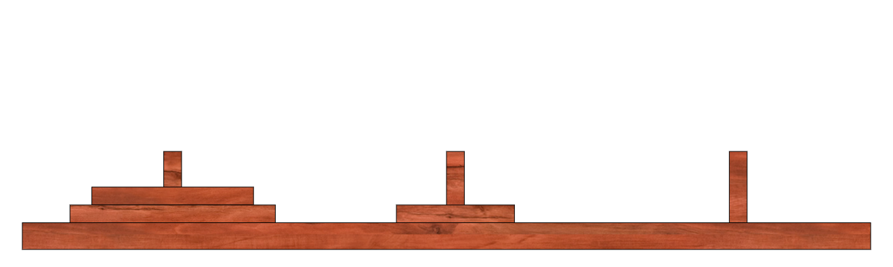
Recursive solution to the “Towers of Hanoi” problem
def hanoi(n, source, target, aux): if n > 0: # move tower of size n - 1 to aux: hanoi(n - 1, source, aux, target) # move disk from source peg to target peg if source: target.append(source.pop()) # move tower of size n-1 from aux to target hanoi(n - 1, aux, target, source) source = [3,2,1] target = [] aux = [] hanoi(len(source),source,target,aux) print source, target, aux
A B C
N = 1 Source Target Aux
Notes:
Right Here. Now The next step of the algorithm states that we have to move the nth disk, that would the top most disk in this case, to the target and that would be B in this case. After we move the disk we have to move the tower of size n-1 which would be 0 from the aux peg that would be C to the target that would be B. A recursive call with arguments 0, C, B,A would be made but since there is nothing to me moved no change would occur in this recursive call. Since we have completed all the steps in the call of honoi(1, A, b, C), we would go back to the honoi (2,A, C, B)

Slide 38
Recursive solution to the “Towers of Hanoi” problem
def hanoi(n, source, target, aux): if n > 0: # move tower of size n - 1 to aux: hanoi(n - 1, source, aux, target) # move disk from source peg to target peg if source: target.append(source.pop()) # move tower of size n-1 from aux to target hanoi(n - 1, aux, target, source) source = [3,2,1] target = [] aux = [] hanoi(len(source),source,target,aux) print source, target, aux
A B C
N = 0 Aux Target Source
Notes:
Now let’s see how it works. Our first task is to move 2 disks from the source to auxilarry.

Slide 39
Recursive solution to the “Towers of Hanoi” problem
def hanoi(n, source, target, aux): if n > 0: # move tower of size n - 1 to aux: hanoi(n - 1, source, aux, target) # move disk from source peg to target peg if source: target.append(source.pop()) # move tower of size n-1 from aux to target hanoi(n - 1, aux, target, source) source = [3,2,1] target = [] aux = [] hanoi(len(source),source,target,aux) print source, target, aux
A B C
N = 1 Source Target Aux

Slide 40
Recursive solution to the “Towers of Hanoi” problem
def hanoi(n, source, target, aux): if n > 0: # move tower of size n - 1 to aux: hanoi(n - 1, source, aux, target) # move disk from source peg to target peg if source: target.append(source.pop()) # move tower of size n-1 from aux to target hanoi(n - 1, aux, target, source) source = [3,2,1] target = [] aux = [] hanoi(len(source),source,target,aux) print source, target, aux
A B C
N = 2 Source Aux Target
Notes:
Since we have tower of 1 disk from the

Slide 41
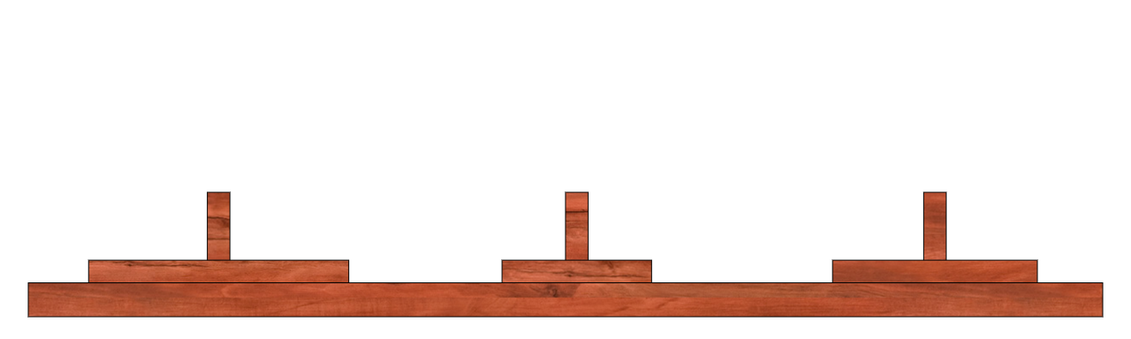
Recursive solution to the “Towers of Hanoi” problem
def hanoi(n, source, target, aux): if n > 0: # move tower of size n - 1 to aux: hanoi(n - 1, source, aux, target) # move disk from source peg to target peg if source: target.append(source.pop()) # move tower of size n-1 from aux to target hanoi(n - 1, aux, target, source) source = [3,2,1] target = [] aux = [] hanoi(len(source),source,target,aux) print source, target, aux
A B C
N = 2 Source Aux Target
Notes:
Now let’s see how it works. Our first task is to move 2 disks from the source to auxilarry.

Slide 42
Recursive solution to the “Towers of Hanoi” problem
def hanoi(n, source, target, aux): if n > 0: # move tower of size n - 1 to aux: hanoi(n - 1, source, aux, target) # move disk from source peg to target peg if source: target.append(source.pop()) # move tower of size n-1 from aux to target hanoi(n - 1, aux, target, source) source = [3,2,1] target = [] aux = [] hanoi(len(source),source,target,aux) print source, target, aux
A B C
N = 1 Aux Source Target
Notes:
Now let’s see how it works. Our first task is to move 2 disks from the source to auxilarry.

Slide 43
Recursive solution to the “Towers of Hanoi” problem
def hanoi(n, source, target, aux): if n > 0: # move tower of size n - 1 to aux: hanoi(n - 1, source, aux, target) # move disk from source peg to target peg if source: target.append(source.pop()) # move tower of size n-1 from aux to target hanoi(n - 1, aux, target, source) source = [3,2,1] target = [] aux = [] hanoi(len(source),source,target,aux) print source, target, aux
A B C
N = 0 Target Source Aux
Notes:
Now let’s see how it works. Our first task is to move 2 disks from the source to auxilarry.

Slide 44
Recursive solution to the “Towers of Hanoi” problem
def hanoi(n, source, target, aux): if n > 0: # move tower of size n - 1 to aux: hanoi(n - 1, source, aux, target) # move disk from source peg to target peg if source: target.append(source.pop()) # move tower of size n-1 from aux to target hanoi(n - 1, aux, target, source) source = [3,2,1] target = [] aux = [] hanoi(len(source),source,target,aux) print source, target, aux
A B C
N = 1 Aux Source Target
Notes:
Now let’s see how it works. Our first task is to move 2 disks from the source to auxilarry.

Slide 45
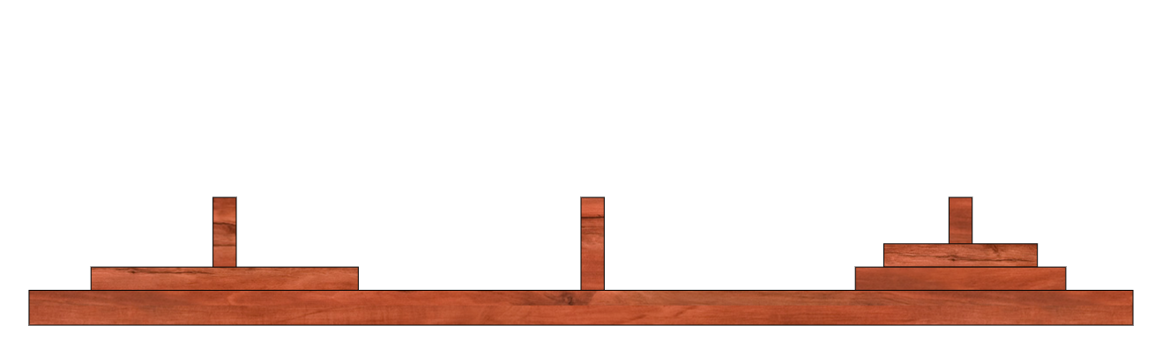
Recursive solution to the “Towers of Hanoi” problem
def hanoi(n, source, target, aux): if n > 0: # move tower of size n - 1 to aux: hanoi(n - 1, source, aux, target) # move disk from source peg to target peg if source: target.append(source.pop()) # move tower of size n-1 from aux to target hanoi(n - 1, aux, target, source) source = [3,2,1] target = [] aux = [] hanoi(len(source),source,target,aux) print source, target, aux
A B C
N = 1 Aux Source Target

Slide 46
Recursive solution to the “Towers of Hanoi” problem
def hanoi(n, source, target, aux): if n > 0: # move tower of size n - 1 to aux: hanoi(n - 1, source, aux, target) # move disk from source peg to target peg if source: target.append(source.pop()) # move tower of size n-1 from aux to target hanoi(n - 1, aux, target, source) source = [3,2,1] target = [] aux = [] hanoi(len(source),source,target,aux) print source, target, aux
A B C
N = 0 Source Aux Target

Slide 47
Recursive solution to the “Towers of Hanoi” problem
def hanoi(n, source, target, aux): if n > 0: # move tower of size n - 1 to aux: hanoi(n - 1, source, aux, target) # move disk from source peg to target peg if source: target.append(source.pop()) # move tower of size n-1 from aux to target hanoi(n - 1, aux, target, source) source = [3,2,1] target = [] aux = [] hanoi(len(source),source,target,aux) print source, target, aux
A B C
N = 1 Aux Source Target

Slide 48
Recursive solution to the “Towers of Hanoi” problem
def hanoi(n, source, target, aux): if n > 0: # move tower of size n - 1 to aux: hanoi(n - 1, source, aux, target) # move disk from source peg to target peg if source: target.append(source.pop()) # move tower of size n-1 from aux to target hanoi(n - 1, aux, target, source) source = [3,2,1] target = [] aux = [] hanoi(len(source),source,target,aux) print source, target, aux
A B C
N = 2 Source Aux Target

Slide 49
Recursive solution to the “Towers of Hanoi” problem
def hanoi(n, source, target, aux): if n > 0: # move tower of size n - 1 to aux: hanoi(n - 1, source, aux, target) # move disk from source peg to target peg if source: target.append(source.pop()) # move tower of size n-1 from aux to target hanoi(n - 1, aux, target, source) source = [3,2,1] target = [] aux = [] hanoi(len(source),source,target,aux) print source, target, aux
A B C
N = 3 Source Target Aux

Slide 50
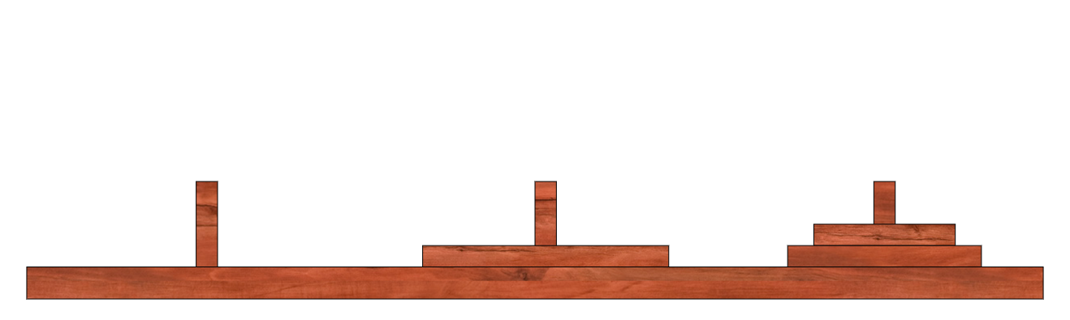
Recursive solution to the “Towers of Hanoi” problem
def hanoi(n, source, target, aux): if n > 0: # move tower of size n - 1 to aux: hanoi(n - 1, source, aux, target) # move disk from source peg to target peg if source: target.append(source.pop()) # move tower of size n-1 from aux to target hanoi(n - 1, aux, target, source) source = [3,2,1] target = [] aux = [] hanoi(len(source),source,target,aux) print source, target, aux
A B C
N = 3 Source Target Aux
Notes:
Now let’s see how it works. Our first task is to move 2 disks from the source to auxilarry.

Slide 51
Recursive solution to the “Towers of Hanoi” problem
def hanoi(n, source, target, aux): if n > 0: # move tower of size n - 1 to aux: hanoi(n - 1, source, aux, target) # move disk from source peg to target peg if source: target.append(source.pop()) # move tower of size n-1 from aux to target hanoi(n - 1, aux, target, source) source = [3,2,1] target = [] aux = [] hanoi(len(source),source,target,aux) print source, target, aux
A B C
N = 2 Aux Target Source
Notes:
Now let’s see how it works. Our first task is to move 2 disks from the source to auxilarry.

Slide 52
Recursive solution to the “Towers of Hanoi” problem
def hanoi(n, source, target, aux): if n > 0: # move tower of size n - 1 to aux: hanoi(n - 1, source, aux, target) # move disk from source peg to target peg if source: target.append(source.pop()) # move tower of size n-1 from aux to target hanoi(n - 1, aux, target, source) source = [3,2,1] target = [] aux = [] hanoi(len(source),source,target,aux) print source, target, aux
A B C
N = 1 Target Aux Source
Notes:
Now let’s see how it works. Our first task is to move 2 disks from the source to auxilarry.

Slide 53
Recursive solution to the “Towers of Hanoi” problem
def hanoi(n, source, target, aux): if n > 0: # move tower of size n - 1 to aux: hanoi(n - 1, source, aux, target) # move disk from source peg to target peg if source: target.append(source.pop()) # move tower of size n-1 from aux to target hanoi(n - 1, aux, target, source) source = [3,2,1] target = [] aux = [] hanoi(len(source),source,target,aux) print source, target, aux
A B C
N = 0 Aux Target Source
Notes:
Now let’s see how it works. Our first task is to move 2 disks from the source to auxilarry.

Slide 54
Recursive solution to the “Towers of Hanoi” problem
def hanoi(n, source, target, aux): if n > 0: # move tower of size n - 1 to aux: hanoi(n - 1, source, aux, target) # move disk from source peg to target peg if source: target.append(source.pop()) # move tower of size n-1 from aux to target hanoi(n - 1, aux, target, source) source = [3,2,1] target = [] aux = [] hanoi(len(source),source,target,aux) print source, target, aux
A B C
N = 1 Target Aux Source
Notes:
Now let’s see how it works. Our first task is to move 2 disks from the source to auxilarry.

Slide 55
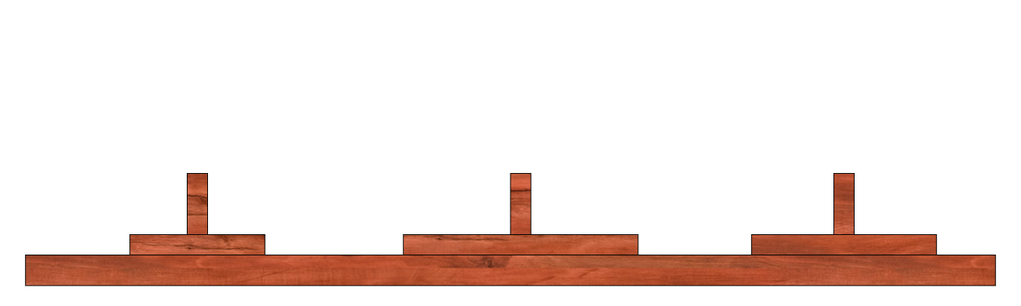
Recursive solution to the “Towers of Hanoi” problem
def hanoi(n, source, target, aux): if n > 0: # move tower of size n - 1 to aux: hanoi(n - 1, source, aux, target) # move disk from source peg to target peg if source: target.append(source.pop()) # move tower of size n-1 from aux to target hanoi(n - 1, aux, target, source) source = [3,2,1] target = [] aux = [] hanoi(len(source),source,target,aux) print source, target, aux
A B C
N = 1 Target Aux Source
Notes:
Now let’s see how it works. Our first task is to move 2 disks from the source to auxilarry.

Slide 56
Recursive solution to the “Towers of Hanoi” problem
def hanoi(n, source, target, aux): if n > 0: # move tower of size n - 1 to aux: hanoi(n - 1, source, aux, target) # move disk from source peg to target peg if source: target.append(source.pop()) # move tower of size n-1 from aux to target hanoi(n - 1, aux, target, source) source = [3,2,1] target = [] aux = [] hanoi(len(source),source,target,aux) print source, target, aux
A B C
N = 0 Target Source Aux
Notes:
Now let’s see how it works. Our first task is to move 2 disks from the source to auxilarry.

Slide 57
Recursive solution to the “Towers of Hanoi” problem
def hanoi(n, source, target, aux): if n > 0: # move tower of size n - 1 to aux: hanoi(n - 1, source, aux, target) # move disk from source peg to target peg if source: target.append(source.pop()) # move tower of size n-1 from aux to target hanoi(n - 1, aux, target, source) source = [3,2,1] target = [] aux = [] hanoi(len(source),source,target,aux) print source, target, aux
A B C
N = 1 Target Aux Source
Notes:
Now let’s see how it works. Our first task is to move 2 disks from the source to auxilarry.

Slide 58
Recursive solution to the “Towers of Hanoi” problem
def hanoi(n, source, target, aux): if n > 0: # move tower of size n - 1 to aux: hanoi(n - 1, source, aux, target) # move disk from source peg to target peg if source: target.append(source.pop()) # move tower of size n-1 from aux to target hanoi(n - 1, aux, target, source) source = [3,2,1] target = [] aux = [] hanoi(len(source),source,target,aux) print source, target, aux
A B C
N = 2 Aux Target Source
Notes:
Now let’s see how it works. Our first task is to move 2 disks from the source to auxilarry.

Slide 59
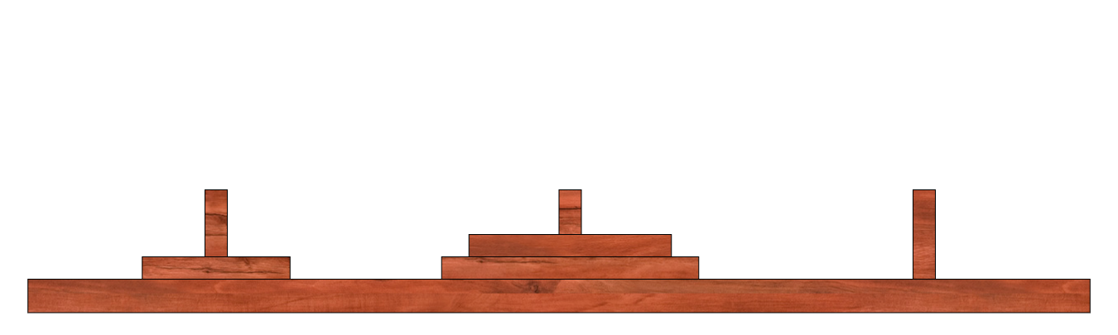
Recursive solution to the “Towers of Hanoi” problem
def hanoi(n, source, target, aux): if n > 0: # move tower of size n - 1 to aux: hanoi(n - 1, source, aux, target) # move disk from source peg to target peg if source: target.append(source.pop()) # move tower of size n-1 from aux to target hanoi(n - 1, aux, target, source) source = [3,2,1] target = [] aux = [] hanoi(len(source),source,target,aux) print source, target, aux
A B C
N = 2 Aux Target Source
Notes:
Now let’s see how it works. Our first task is to move 2 disks from the source to auxilarry.

Slide 60
Recursive solution to the “Towers of Hanoi” problem
def hanoi(n, source, target, aux): if n > 0: # move tower of size n - 1 to aux: hanoi(n - 1, source, aux, target) # move disk from source peg to target peg if source: target.append(source.pop()) # move tower of size n-1 from aux to target hanoi(n - 1, aux, target, source) source = [3,2,1] target = [] aux = [] hanoi(len(source),source,target,aux) print source, target, aux
A B C
N = 1 Source Target Aux
Notes:
Now let’s see how it works. Our first task is to move 2 disks from the source to auxilarry.

Slide 61
Recursive solution to the “Towers of Hanoi” problem
def hanoi(n, source, target, aux): if n > 0: # move tower of size n - 1 to aux: hanoi(n - 1, source, aux, target) # move disk from source peg to target peg if source: target.append(source.pop()) # move tower of size n-1 from aux to target hanoi(n - 1, aux, target, source) source = [3,2,1] target = [] aux = [] hanoi(len(source),source,target,aux) print source, target, aux
A B C
N = 0 Source Aux Target
Notes:
Now let’s see how it works. Our first task is to move 2 disks from the source to auxilarry.

Slide 62
Recursive solution to the “Towers of Hanoi” problem
def hanoi(n, source, target, aux): if n > 0: # move tower of size n - 1 to aux: hanoi(n - 1, source, aux, target) # move disk from source peg to target peg if source: target.append(source.pop()) # move tower of size n-1 from aux to target hanoi(n - 1, aux, target, source) source = [3,2,1] target = [] aux = [] hanoi(len(source),source,target,aux) print source, target, aux
A B C
N = 1 Source Target Aux
Notes:
Now let’s see how it works. Our first task is to move 2 disks from the source to auxilarry.

Slide 63
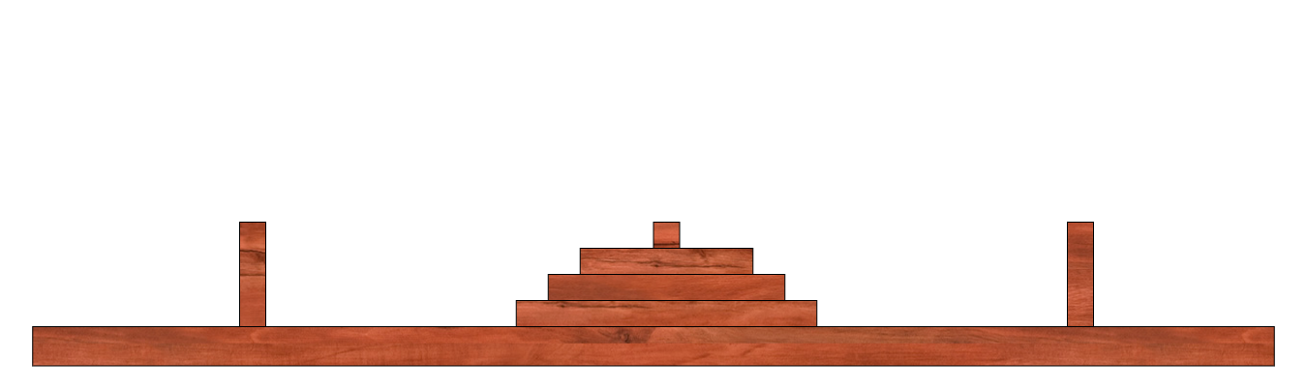
Recursive solution to the “Towers of Hanoi” problem
def hanoi(n, source, target, aux): if n > 0: # move tower of size n - 1 to aux: hanoi(n - 1, source, aux, target) # move disk from source peg to target peg if source: target.append(source.pop()) # move tower of size n-1 from aux to target hanoi(n - 1, aux, target, source) source = [3,2,1] target = [] aux = [] hanoi(len(source),source,target,aux) print source, target, aux
A B C
N = 1 Source Target Aux
Notes:
Now let’s see how it works. Our first task is to move 2 disks from the source to auxilarry.

Slide 64
Recursive solution to the “Towers of Hanoi” problem
def hanoi(n, source, target, aux): if n > 0: # move tower of size n - 1 to aux: hanoi(n - 1, source, aux, target) # move disk from source peg to target peg if source: target.append(source.pop()) # move tower of size n-1 from aux to target hanoi(n - 1, aux, target, source) source = [3,2,1] target = [] aux = [] hanoi(len(source),source,target,aux) print source, target, aux
A B C
N = 0 Aux Target Source
Notes:
Now let’s see how it works. Our first task is to move 2 disks from the source to auxilarry.

Slide 65
Recursive solution to the “Towers of Hanoi” problem
def hanoi(n, source, target, aux): if n > 0: # move tower of size n - 1 to aux: hanoi(n - 1, source, aux, target) # move disk from source peg to target peg if source: target.append(source.pop()) # move tower of size n-1 from aux to target hanoi(n - 1, aux, target, source) source = [3,2,1] target = [] aux = [] hanoi(len(source),source,target,aux) print source, target, aux
A B C
N = 1 Source Target Aux
Notes:
Now let’s see how it works. Our first task is to move 2 disks from the source to auxilarry.

Slide 66
Recursive solution to the “Towers of Hanoi” problem
def hanoi(n, source, target, aux): if n > 0: # move tower of size n - 1 to aux: hanoi(n - 1, source, aux, target) # move disk from source peg to target peg if source: target.append(source.pop()) # move tower of size n-1 from aux to target hanoi(n - 1, aux, target, source) source = [3,2,1] target = [] aux = [] hanoi(len(source),source,target,aux) print source, target, aux
A B C
N = 2 Aux Target Source
Notes:
Now let’s see how it works. Our first task is to move 2 disks from the source to auxilarry.

Slide 67
Recursive solution to the “Towers of Hanoi” problem
def hanoi(n, source, target, aux): if n > 0: # move tower of size n - 1 to aux: hanoi(n - 1, source, aux, target) # move disk from source peg to target peg if source: target.append(source.pop()) # move tower of size n-1 from aux to target hanoi(n - 1, aux, target, source) source = [3,2,1] target = [] aux = [] hanoi(len(source),source,target,aux) print source, target, aux
A B C
N = 3 Source Target Aux
Notes:
Now let’s see how it works. Our first task is to move 2 disks from the source to auxilarry.

Slide 68
Closing Thoughts
Recursive functions call themselves one or more times
Recursive functions must converge to the base case
Recursive solutions are more “natural” but iterative solutions often perform better.

